Slide 1
Exploring the Labyrinth: Supporting Sexual Minority College Males’ Multiple Identity Development
Daniel Tillapaugh, Ph.D.
University of Maine

Slide 2
CCAPS Continuing Education
There is no conflict of interest in this presentation.

Slide 3
Overview of Presentation
Introduction & Welcome
Defining Terms
Overview of Literature
Methodology
Findings
Implications for Practice & Research
Working in the Intersections

Slide 4
Defining Terms
Sexual Minority
Male vs. Men

Slide 5
Overview of the Literature
College men and masculinities
(Davis & Laker, 2004; Edwards & Jones, 2009; Harris, 2006; Harper & Harris, 2010; Laker & Davis, 2011).
LGBT identity development
(Berila, 2011; Cass, 1979; D’Augelli, 1994; Fassinger, 1998; Tillapaugh, 2012; Wilkerson, Ross, & Brooks, 2009)
Intersectionality
(Abes, Jones, & McEwen, 2007; Collins, 1990; Dill & Zambrana, 2009; Jones & McEwen, 2000)

Slide 6
Methodology
Constructivist grounded theory (Charmaz, 2006)
26 sexual minority cisgender male participants either juniors, seniors, or recent grads in U.S. or Canadian colleges/universities (2014) & 17 cisgender gay males at three universities in Southern California (2012)
Individuals recruited via list-servs, Facebook, Twitter, & Reddit
Two in-depth interviews and 11 journal prompt responses

Slide 7
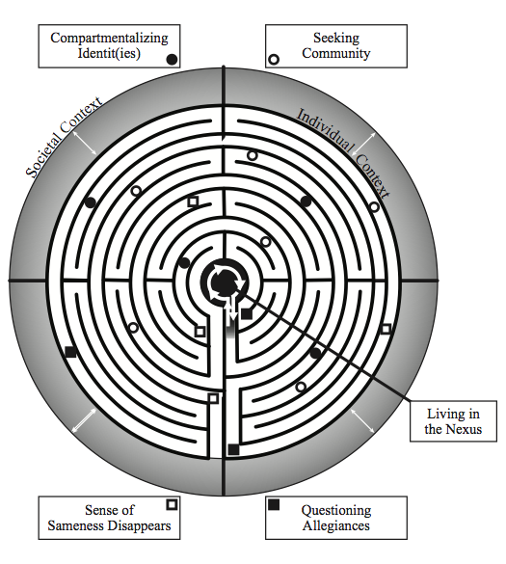
The Labyrinth Model

Slide 8
Findings
Five main themes:
Sense of sameness disappears
Compartmentalizing identities
Seeking community
Questioning allegiances
Living in the nexus

Slide 9
Sense of Sameness Disappears
Acknowledging one’s sexual minority identity
Coming out to others
Maintaining hegemonic masculinity
Troubling one’s privilege
Notes:
LGBT student organizations, sexuality and/or gender studies academic programs, and virtual LGBT community important (read Adam’s quote and Joshua’s quote)
Only 9 out of 26 participants were involved in their campus LGBT student organizations – “cliques” “full of drama” – those who upheld the importance of being perceived as masculine were more likely not to be involved. Matthew’s experience of no LGBT group on his campus. Marginalization in and out of the classroom.
Virtual spaces – gaymers community or Reddit: gaybros

Slide 10
Compartmentalizing Identit(ies)
Mirroring others and the consequences of that
Not finding one’s self in media images
Tension between one’s sexuality and other social identities
Engaging in posturing behavior
Notes:
Intimate relationships with other males: majority had engaged in same-sex sexual behaviors in college; only 5 of the 26 were involved in a significant long-term relationship
Often held a heteronormative and hegemonic view on sexual roles within sexual behavior
Experiences of sexual behavior both positive and negative – most had positive experiences; others expressed their perceptions of needing to have sex with others and Greyson’s experience of acquaintance rape
Those in intimate relationships (short or long-term) had greater understanding of expectations around gender roles through those relationships

Slide 11
Seeking Community
Campus environments as safe spaces
Importance of campus involvement
Use of technology
Making other sexual minority friends
Sexual behaviors and same-sex relationship
Immersion into the off-campus LGBT community
Notes:
18 of the 26 participants served in leadership roles on campus – often provided the participants a level of visibility on campus
Those involved in LGBT organizations/resource centers, often made meaning of both their leadership and their multiple identities – read Adam’s quote.
Connected to mentors – either as faculty, staff, or peers, and had an increased support network on campus which lead to a stronger sense of belonging

Slide 12
Questioning Allegiances
Experimentation and risk-taking
Clarifying campus involvement
Internal tensions of personal identity
Notes:
Institutional differences between campus environments was a significant factor in the students’ exposure to heterosexism and heteronormativity.
Those in more urban spaces characterized their campus as “inclusive” or places where it was “quite easy to be out on campus” Those in rural areas stated that they felt that their sexuality “causes one to sick out like a sore thumb” and that they received “conflicting messages sent from peers who conflate issues regarding insecurity about gender expression (Am I ‘manly’ enough? Am I supposed to be?) and sexuality”
Those in rural spaces often lacked strong local support networks and were instead often connected more to others through virtual means
Experiences of tokenization by some participants based upon geographical areas (read David’s quote starting at bottom of p. 17).

Slide 13
Living in the Nexus
Moving from external to internal influences
Feeling secure in one’s sense of self and multiple identities
Resolving the tensions of one’s identities: Identity salience
Thinking about the future

Slide 14
Implications
Importance of counter-spaces for LGBT students
Self-reflection as critical influence
Working toward healthy and positive masculinity for college males
Campus environmental differences and the need for understanding campus climate for LGBT students
The need for out sexual minority male mentors and role models

Slide 15
Working in the Intersections
Jordan, a White, 20-year-old junior at the University of Washington, is an active student leader on his campus. He serves as a resident assistant, engages in political activism within the Democratic Party, and participates in student government. While he identifies as gay, he feels as those he often is able to “pass” for being straight, saying “I definitely think that my higher level of masculinity might put me into a privilege [sic] higher than another gay man because people don’t perceive me as gay as much.” He mentions that he does not participate in LGBT campus life beyond his friend group, reflecting that he wanted to avoid the “drama” he perceived occurred within the on-campus LGBT organization.
He mentioned how his resident assistant position has helped him make meaning of his own privilege, which built on an experience during his first year when he attended a friend’s presentation on diversity and identity. He commented:
Since that point, I have engaged with others (students, supervisors, and mentors) about these intersections. After talking with them, I began to see how intersections could play larger roles than I had previously thought. For example, I had never really thought about how being a White, cisgendered, gay man holds power. An example of that power is that White, cis, gay men are the face of the gay rights movement and of gay men in the media….Understanding the intersection of multiple identities was easily comprehensible to me, and with further reading and engaging with others in conversation in this issue, I learn more and more.
Notes:
How might you make sense of the intersections of Jordan’s sense of gender and sexuality? If you were working with him, what might be some things regarding his identity development that you would keep in mind?
If you were serving as his advisor/supervisor, what critical influences might you recommend to Jordan to help enhance his meaning-making of his gender performance as it connects to his sexuality?
When considering the labyrinth model, what might be some considerations for higher education professionals to consider to support Jordan and his meaning-making?

Slide 16
Working in the Intersections
Joshua, a 21-year-old African American gay male, attends the University of Louisiana, Lafayette. Active as a student leader on campus, he has led his campus’s LGBT student organization and is actively involved in the Black Journalist Association on-campus. He is completely out on campus and named being asked to perform in drag at a large campus event for students, faculty, and administrators as one of the highlights of his college experience thus far.
In his discussions, he shared how experiences of discrimination served as motivation for him to continue being his own authentic self in all aspects of his identities. He recalled a recent experience where an African-American male drove past him walking to campus and yelled “fucking faggot.” He commented:
Did it hurt my feelings? Temporarily. Did I react? No. Here’s why: My feelings were hurt not only because of the obvious verbal abuse, but mainly because these were members of the African American community – it always is. Do I believe African Americans are more homophobic? I do not. However, I do feel like these individuals see me as a closer representation of who they are than someone who is White or otherwise. Therefore, if they are insecure about their sexual orientation or gender identity, I am nothing but a flesh and bone reminder of who they are on the inside.
Continuing on, Joshua stated, “My form of activism is living my life, openly and honestly, as a gay black man. Considering how I can count the number of people who do that on one hand…, my unapologetic existence is activism enough.”
Notes:
How might you make sense of the intersections of Joshua’s race, gender, and sexuality? If you were working with him, what might be some things regarding his identity development that you would keep in mind?
If you were serving as his advisor/supervisor, what critical influences might you recommend to Joshua to help enhance his meaning-making of his gender performance as it connects to his sexuality?
When considering the labyrinth model, what might be some considerations for higher education professionals to consider to support Joshua and his meaning-making?

Slide 17
Sphere of Influence
What is one thing that you’re taking away from this session that you can put into your own professional practice to support sexual minority males and their multiple identity development on your campus?

Slide 18
Thank you!
Contact me:
Dan Tillapaugh
daniel.tillapaugh@maine.edu
Twitter: @dtillapaugh

