Slide 1
Enhancing Collaboration by Examining Faculty and Student Affairs Professionals through an Intercultural Lens
Dr. Shelly Myers
Director, University College
University of North Carolina – Wilmington
myersm@uncw.edu

Slide 2
A Place to Start
Today’s Climate
Student Learning
Collaboration
Culture
Organizational Culture
Subcultures

Slide 3
COLLABORATION
“is a process through which parties who see different aspects of a problem can constructively explore their differences and search for solutions that go beyond their own limited vision of what is possible.”
Gray, 1989

Slide 4
Organizational Culture: Simply, the way we do things around here.
Beliefs
Values
Rituals
Heroes
Processes/Systems
Org. Structure
Training
Power Structure
Rewards

Slide 5
Two Inhibitors of Collaboration
Lack of knowledge or negative perceptions of the “other” culture
Limited perceptions of our own subculture

Slide 6
Self-Reflection & Partner sharing
Views
Beliefs
Perceptions
Thoughts
Mental Models
Assumptions
Opinions
Analysis

Slide 7
Collaborative Work Groups
Histories and Training
Work Structures
Definition of Student Learning
Work Roles & Responsibilities
Power and Resources

Slide 8
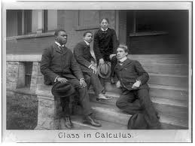
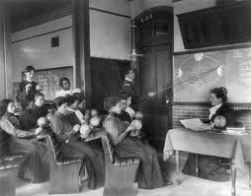
Histories & Training

Slide 9
Histories & Training
Birth and Growth of Student Affairs
Graduate Programs
New Employee Training
Professional Development

Slide 10
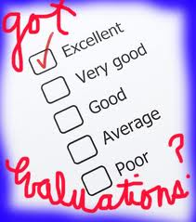
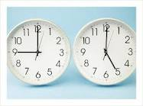
Work Structures
Schedules
Rewards and Incentives
Promotion and Tenure
Opportunities for Interaction

Slide 11
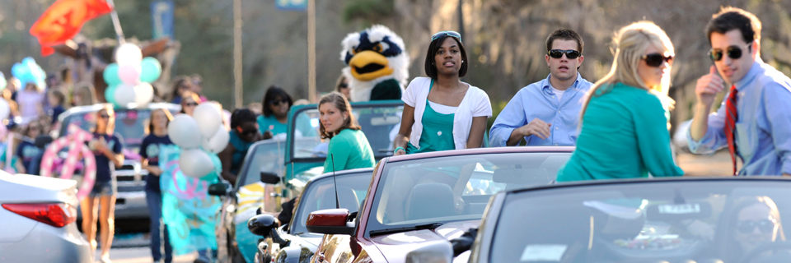
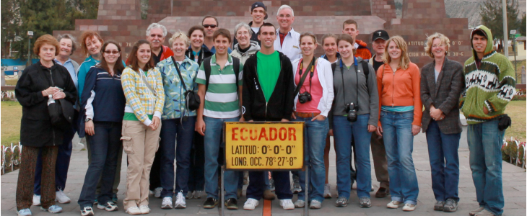
Definition of Student Learning

Slide 12
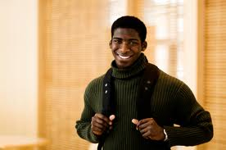
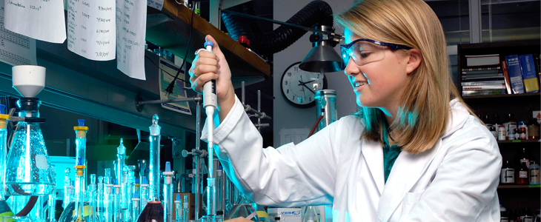
Definition of Student Learning
Shared commitment to student success and student learning
Faculty definition
Student Affairs’ definition

Slide 13
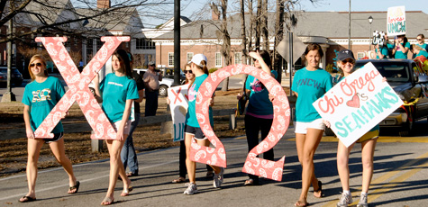
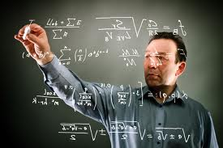
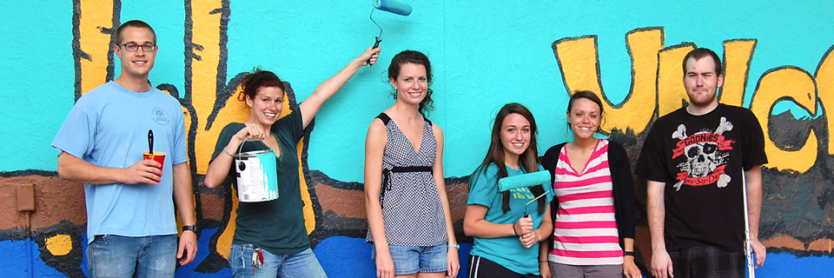
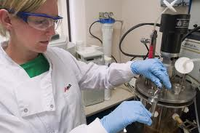
Work Roles & Responsibilities

Slide 14
Work Roles & Responsibilities
How do Faculty and Student Affairs Professionals define their OWN and the OTHER cultures’ roles and responsibilities?
Student Affairs Professionals who moved into the Faculty ranks
Defining Student Affairs Professionals’ Roles
Globalism V. Localism

Slide 15
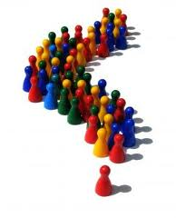
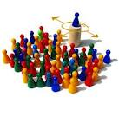
Power & Resources
Power Distance
Large Power Distance
Small Power Distance
Resources

Slide 16
What can we do to improve collaboration?
Increase awareness of our own “mental models” – those we have about our own subculture and those we have about the other subculture.
Learn about the other subculture.
Build interpersonal relationships.

Slide 17
Self-Reflection and Personal Writing activity

Slide 18
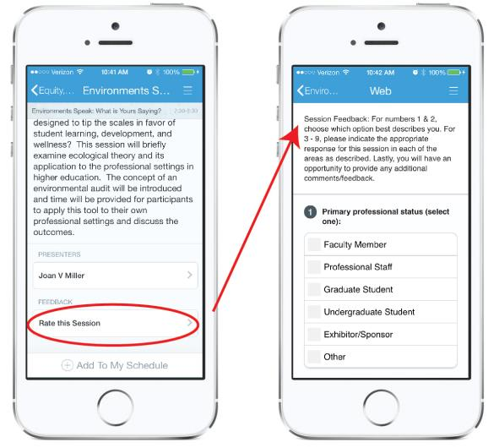
Please Rate This Session in Guidebook
Find this session in Guidebook
Scroll to bottom and click on “Rate this session”
Complete Session Feedback Form

