Slide 1
Involvement, Gender, and the Color Line: Reinventing Male Student Engagement
Jacob Isaacs – Ivy Tech Community College
Dr. Paul Porter – University of Scranton

Slide 2
Introductions
Jacob Isaacs
Dr. Paul Porter
Associate Professor of Communication
Ivy Tech Community College – Lafayette
15+ years advising student organizations
Director of Multicultural Affairs
University of Scranton
Emphasis on Black Male Leadership Development

Slide 3
Perception Check

Slide 4
Men and Student Engagement

Slide 5
Student Engagement
Increased Student Engagement Leads to:
Increased Learning
Higher Retention
Increased Student Satisfaction
Higher Completion Rates
(Astin, 1999; Davalos et al., 1999; Fischer, 2007; Kuh et al., 1991; Tinto, 1993)

Slide 6
College Men and Engagement
College men are especially prone to these trends of student engagement. (Laker, 2011)
Many HE institutions perpetuate gender stereotypes of college men. (Johnson, 2001)
College men typically will not ask for help.

Slide 7
NSSE and Male Engagement
College males excel over females in only about 1/3 of the categories of engagement.
Examples are exercising and relaxing (NSSE, 2009).
Men are less engaged in 2/3 of categories, including ones of academic and long-term developmental importance (Weaver-Hightower, 2010):
Participating in study abroad
Coming to class prepared
Participating in civic/community outreach
Reading books outside of those required for coursework

Slide 8
NSSE and Male Engagement
Men who choose not to become involved in these and other co-curricular programs limit their opportunities for productive engagement in college (Harris & Struve, 2009) and, as a result, threaten their long-term academic success.

Slide 9
Complicating Perceptions of Men

Slide 10
Men as Gendered Beings
Masculinity is a “socially constructed identity” (Harris III & Struve, 2009, p. 3) and, as such, can change.
Men “must always be viewed in the context of the restraints, constraints, and expectations of the male gender role [because] men are inextricably entwined with the demands of our culture” (Scher, 1990, p. 325).

Slide 11
Masculinities
Intersected and influenced by other dimensions of identity such as race/ethnicity, sexual orientation, religious faith, sexual orientation and [dis]ability (Harris, 2008).
Baker (2008) notes that any of these under-represented groups are more likely to feel isolated and disconnected from the environments of their college, which places them under an even greater threat of non-completion (Feagin et al 1996; Hurtado, 1992; Nagasawa and Wong, 1999; Smith and Moore, 2002).

Slide 12
Overheard @ Student Affairs Conferences
Immature
Apathetic
Egotistical
Heavy Drinkers
Promiscuous
Vandals
Violent
Competitive
Hypermasculine
Troubled

Slide 13
Perceptions of Men
Dichotomy of masculinity (Edwards & Jones, 2009)
Society’s expectations of the “ideal male”.
Personal ambitions for success and well-being.
Fallacies about men
Men as the “typical college student” ("The case of the missing men," 2007).
Men as “problem-free”.
Men as unworthy of specialized assistance, due to historical privilege.
All of these especially pertain to White men.

Slide 14
Men’s Perceptions of Masculinity
Dissertation Study
12 college men
Traditional-age (18-23 years old)
½ hour to 1-hour interviews
Attendees at a men’s college (Wabash College)

Slide 15
Men’s Perceptions of Masculinity
Potential common themes
Responsibility
Respect
Poise
Athleticism/Fitness
No universal themes, though!

Slide 16
Starting Points for Men

Slide 17
Starting Points for Men
Programs need to focus on development and success of college men.
Academic and Professional Mentoring
Fellowship and Networking
Build Multicultural and Socioeconomic Competence
Initiatives that encourage men where they are
York College
Lone Star Community College
Project VOICE – University of Scranton

Slide 18
Delta Pi Chapter, Theta Chi Fraternity

Slide 19
Take action to help your college men succeed.

Slide 20
Pass the Mic: Project VOICE at The University of Scranton
Dr. Paul Porter
University of Scranton

Slide 21
“While we may often think of an educational environment as being composed of lifeless objects like classrooms, buildings, tables,, and chairs, it is also about people and relationships. Who students live, play, and learn with has great potential to influence how they experience their campuses, perform in classrooms, and develop as thinkers and citizens.”
Karen Griffin & Walter Allen
Associate Editors: 2011 ASHE Reader on Racial and Ethnic Diversity in Higher Education

Slide 22
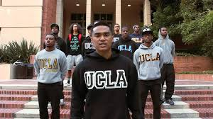
Problems Plaguing Minority Male Engagement
Buried under the Deficit Model Narrative (Harper, 2006a; Harper, 2012; Pittman, 2014; Saenz & Ponjuan, 2011)
Empty in the Middle
Research tends to highlight the polar extremes, while ignoring the “average” man of color
The “Unrepresented” Population (Jackson, 2003; Jackson & Daniels, 2004; Stewart, 2014;)
Nothing/No one on their campuses that look like them/indicate that campus belongs to them.
Circumventing the topic of race

Slide 23
Theoretical Framework: Critical Race Theory
Premise
Racism is a common piece of our social fabric
Racism is aided and abetted by interest convergence
Racism is socially constructed
Racism must be challenged
Racism can be challenged by shared narratives, spaces, and priorities

Slide 24
Critical Race Theory
Common Themes
Counterstorytelling
Stories of the silenced
Empathic Fallacy
Belief that one narrative can change another
Counterspace
Save enclaves for underrepresented populations
Interest Convergence
Mainstream populations recognize minority interests only when mainstream populations are affected
Cultural Pluralism
Separate cultural existences in common space
Racial Battle Fatigue
The physical and mental effects of coping with discrimination

Slide 25
Project VOICE: Men of Color Engagement Initiative
Mission
Through a lens of empowerment, project-based learning and dialogue, Project VOICE uses a broad based approach to developing successful habits of scholarship, adjusting to college life, fostering intellectual curiosity and demonstrating ethical student citizenship within and beyond the campus community.

Slide 26
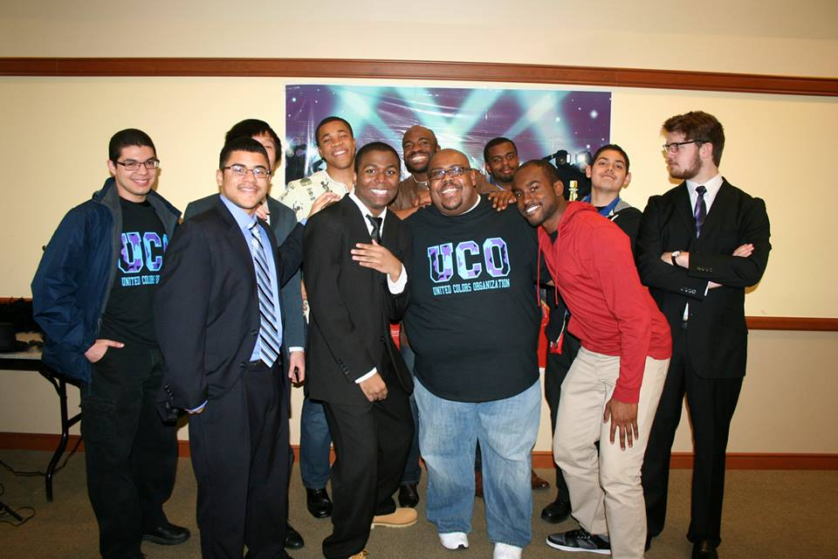
Project VOICE: Men of Color Engagement Initiative
Goals
Improve overall student experience
Influence campus engagement and involvement
Provide outlet to articulate observations, hopes, fears, etc concerning campus and social world around them;
Peer-to-peer mentorship
Local outreach

Slide 27
Project VOICE: Men of Color Engagement Initiative
Activities
FELLOWship Dinners
Brothers & Bagels
On Point (monthly podcast)
Information table at Women’s Center Take Back the Night event
Spring football game field trip
Men of color dinner and discussion event

Slide 28
Critical Race Theory and Project VOICE
Provides a new narrative and a powerful means
People as counterspace
Dialogue of Proactive vs. Reactive
Ally development as common bond
Our men are tired

Slide 29
Discussion
Does a new narrative reverse the old narrative?
Men of Color as Muted Group?
Shared accountability for Underrepresented populations
Reviving this population
Does Project VOICE fix racism?

Slide 30
References
Astin, A. W. (1999). Student involvement: A developmental theory for higher education. Journal of College Student Development, 40(5), 518-529.
Baker, C. N. (2008). Under-represented college students and extracurricular involvement: The effects of various student organizations on academic performance. Social Psychology Education, 11, 273-298.
Davalos, D. B., Chavez, E. L., & Guardiola, R. J. (1999). The effects of extracurricular activity, ethnic identiﬁcation, and perception of school on student dropout rates. Hispanic Journal of Behavioral Sciences, 21, 61–77.
Feagin, J. R., Vera, H., & Imani, N. (1996). The agony of education: Black students at white colleges and universities. New York: Routledge.
Fischer, M. J. (2007). Settling into campus life: Differences by Race/Ethnicity in college involvement and outcomes. Journal of Higher Education, 78, 125–161.
Harris, F. (2008). Deconstructing masculinity: A qualitative study of college men's masculine conceptualizations and gender performance. NASPA Journal, 45(4), 453-474.
Harris, F., & Struve, L. (2009). Gents, jerks, and jocks: What male students learn about masculinity n college. About Campus, 14(3), 2-9.
Hurtado, S. (1992). The campus racial climate: Contexts of conﬂict. Journal of Higher Education, 63, 539–569.

Slide 31
References
Johnson, A. (2001). The gender knot: Unlocking our patriarchal legacy. Philadelphia, PA: Temple University Press.
Kuh, G. D., Schuh, J. H., Whitt, E. J., and Associates (1991). Involving Colleges: Encouraging Student Learning and Personal Development Through Out-of-Class Experiences, Jossey-Bass, San Francisco.
Laker, J. A. (2011). Inviting and inspiring men to learn: Gendered pedagogical considerations for undergraduate teaching and learning environments. In J. A. Laker & T. Davis (Eds.), Masculinities in higher education: Theoretical and practical considerations. New York, NY: Routledge.
Nagasawa, R., & Wong, P. (1999). A theory of minority students’ survival in college. Sociological Inquiry, 69, 76–90.
National Survey of Student Engagement (NSSE). (2009). Retrieved from http://nsse.iub.edu/ 2009_Institutional_Report/pdf/ 2009%20Grand%20Means%20Class%20and%20Gender.pdf
Pascarella, E. T., & Terenzini, P. (2005). How college affects students: A third decade of research (Vol. 2). San Francisco, CA: Jossey-Bass Publishers.

Slide 32
References
Smith, S., & Moore, M. (2002). Expectations of campus racial climate and social adjustment among african american college students. In: W. Allen, M. Spencer, & C. O’Conner (Eds.), African American education: Race community, inequality, and achievement (pp. 93–118). NY: Elsever Science Ltd.
Weaver-Hightower, M. B. (2010). Where the guys are: Males in higher education. Change, 29-35.

Slide 33
References
Jackson, J.F.L., & Daniels, B.D. (2004). Summary Report: Race, Gender, Length of Employment and NASPA IV East: A Regional Perspective within a National Context , Madison, Wisconsin, University of Wisconsin System, The Institute on Race and Ethnicity.
Jackson, J.F.L. (2003). Engagement, Retention, and Advancement for Administrators of Color in Higher and Postsecondary Education: A Summary Report, Madison, Wisconsin, University of Wisconsin System, The Institute on Race and Ethnicity.
Delgado, R., & Stefancic, J. (2011). Critical race theory: An introduction. New York: NYU Press.
Harper, S. R. (2006a). Black male students at public universities in the U.S.: Status, trends and implications for policy and practice. Washington, DC: Joint Center for Political and Economic Studies.
Harper, S. R. (2012). Black male student success in higher education: A report from the National Black Male College Achievement Study. Philadelphia: University of Pennsylvania , Center for the Study of Race and Equity in Education.
Pittman, E (2014). Helping young Black, Latino men succeed through support and challenging stereotypes. Diversity Issues in Higher Education . Retrieved from http://diverseeducation.com/article/61114.
Saenz, V. B., & Ponjuan, L. (2011). Men of color: Ensuring the academic success of Latino males in higher education. Washington, DC: The Institute for Higher Education Policy.
Stewart, P. (2014). Too many women or not enough men? Diversity Issues in Higher Education, 31 (3), pp 46-48.

