Slide 1
New Career Development PATHS for Underrepresented Groups
Cultivating Career Development Approaches for First-Generation,
Low-Income and Students of Color
Eric Mata
Assistant Director,
Post-College Success Initiatives
Office of Multicultural Student Success
DePaul University
Richard Morales
Director,
Career Planning and Placement
Washburn Culinary Institute
Kennedy King College

Slide 2
Overview
Our Entry
Our Current Work
Capturing Success
Next Steps
Career Center Partnership
Things to Consider

Slide 3
Our Entry
from PATHS to Post-College Success

Slide 4
What brought us to do this work
A change in leadership occurred. In 2009 OMSS re-structured programs to increase scalability and outreach to first-generation students.
STARS Mentoring program did not have a "next step" program after their freshman year.
Literature review was written focusing on Sophomore Slump, Social Capital, and Molly Schaller's "Wandering and Wondering: Traversing the Uneven Terrain of the Second College Year. About Campus (2009).
Notes:
What Brought us…
Leadership Change in OMSS; charged to increase scale and reach among first-generation students.
STARS did not have a next step; thus leading to a creation of a sophomore program
Lead to Lit Review; discovered
Sophomore Slump – sense of lost of community, classes are harder, early stages of life choices (major, career, etc).
First – generation Students did have the social capital to successfully choose the right career
Molly Schaller’s was our foundation with lead to PATHS (Career Discernment Program for FGs)
When we put all this together and applied it to our first-gen students; realized students were experiencing a chokepoint.

Slide 5
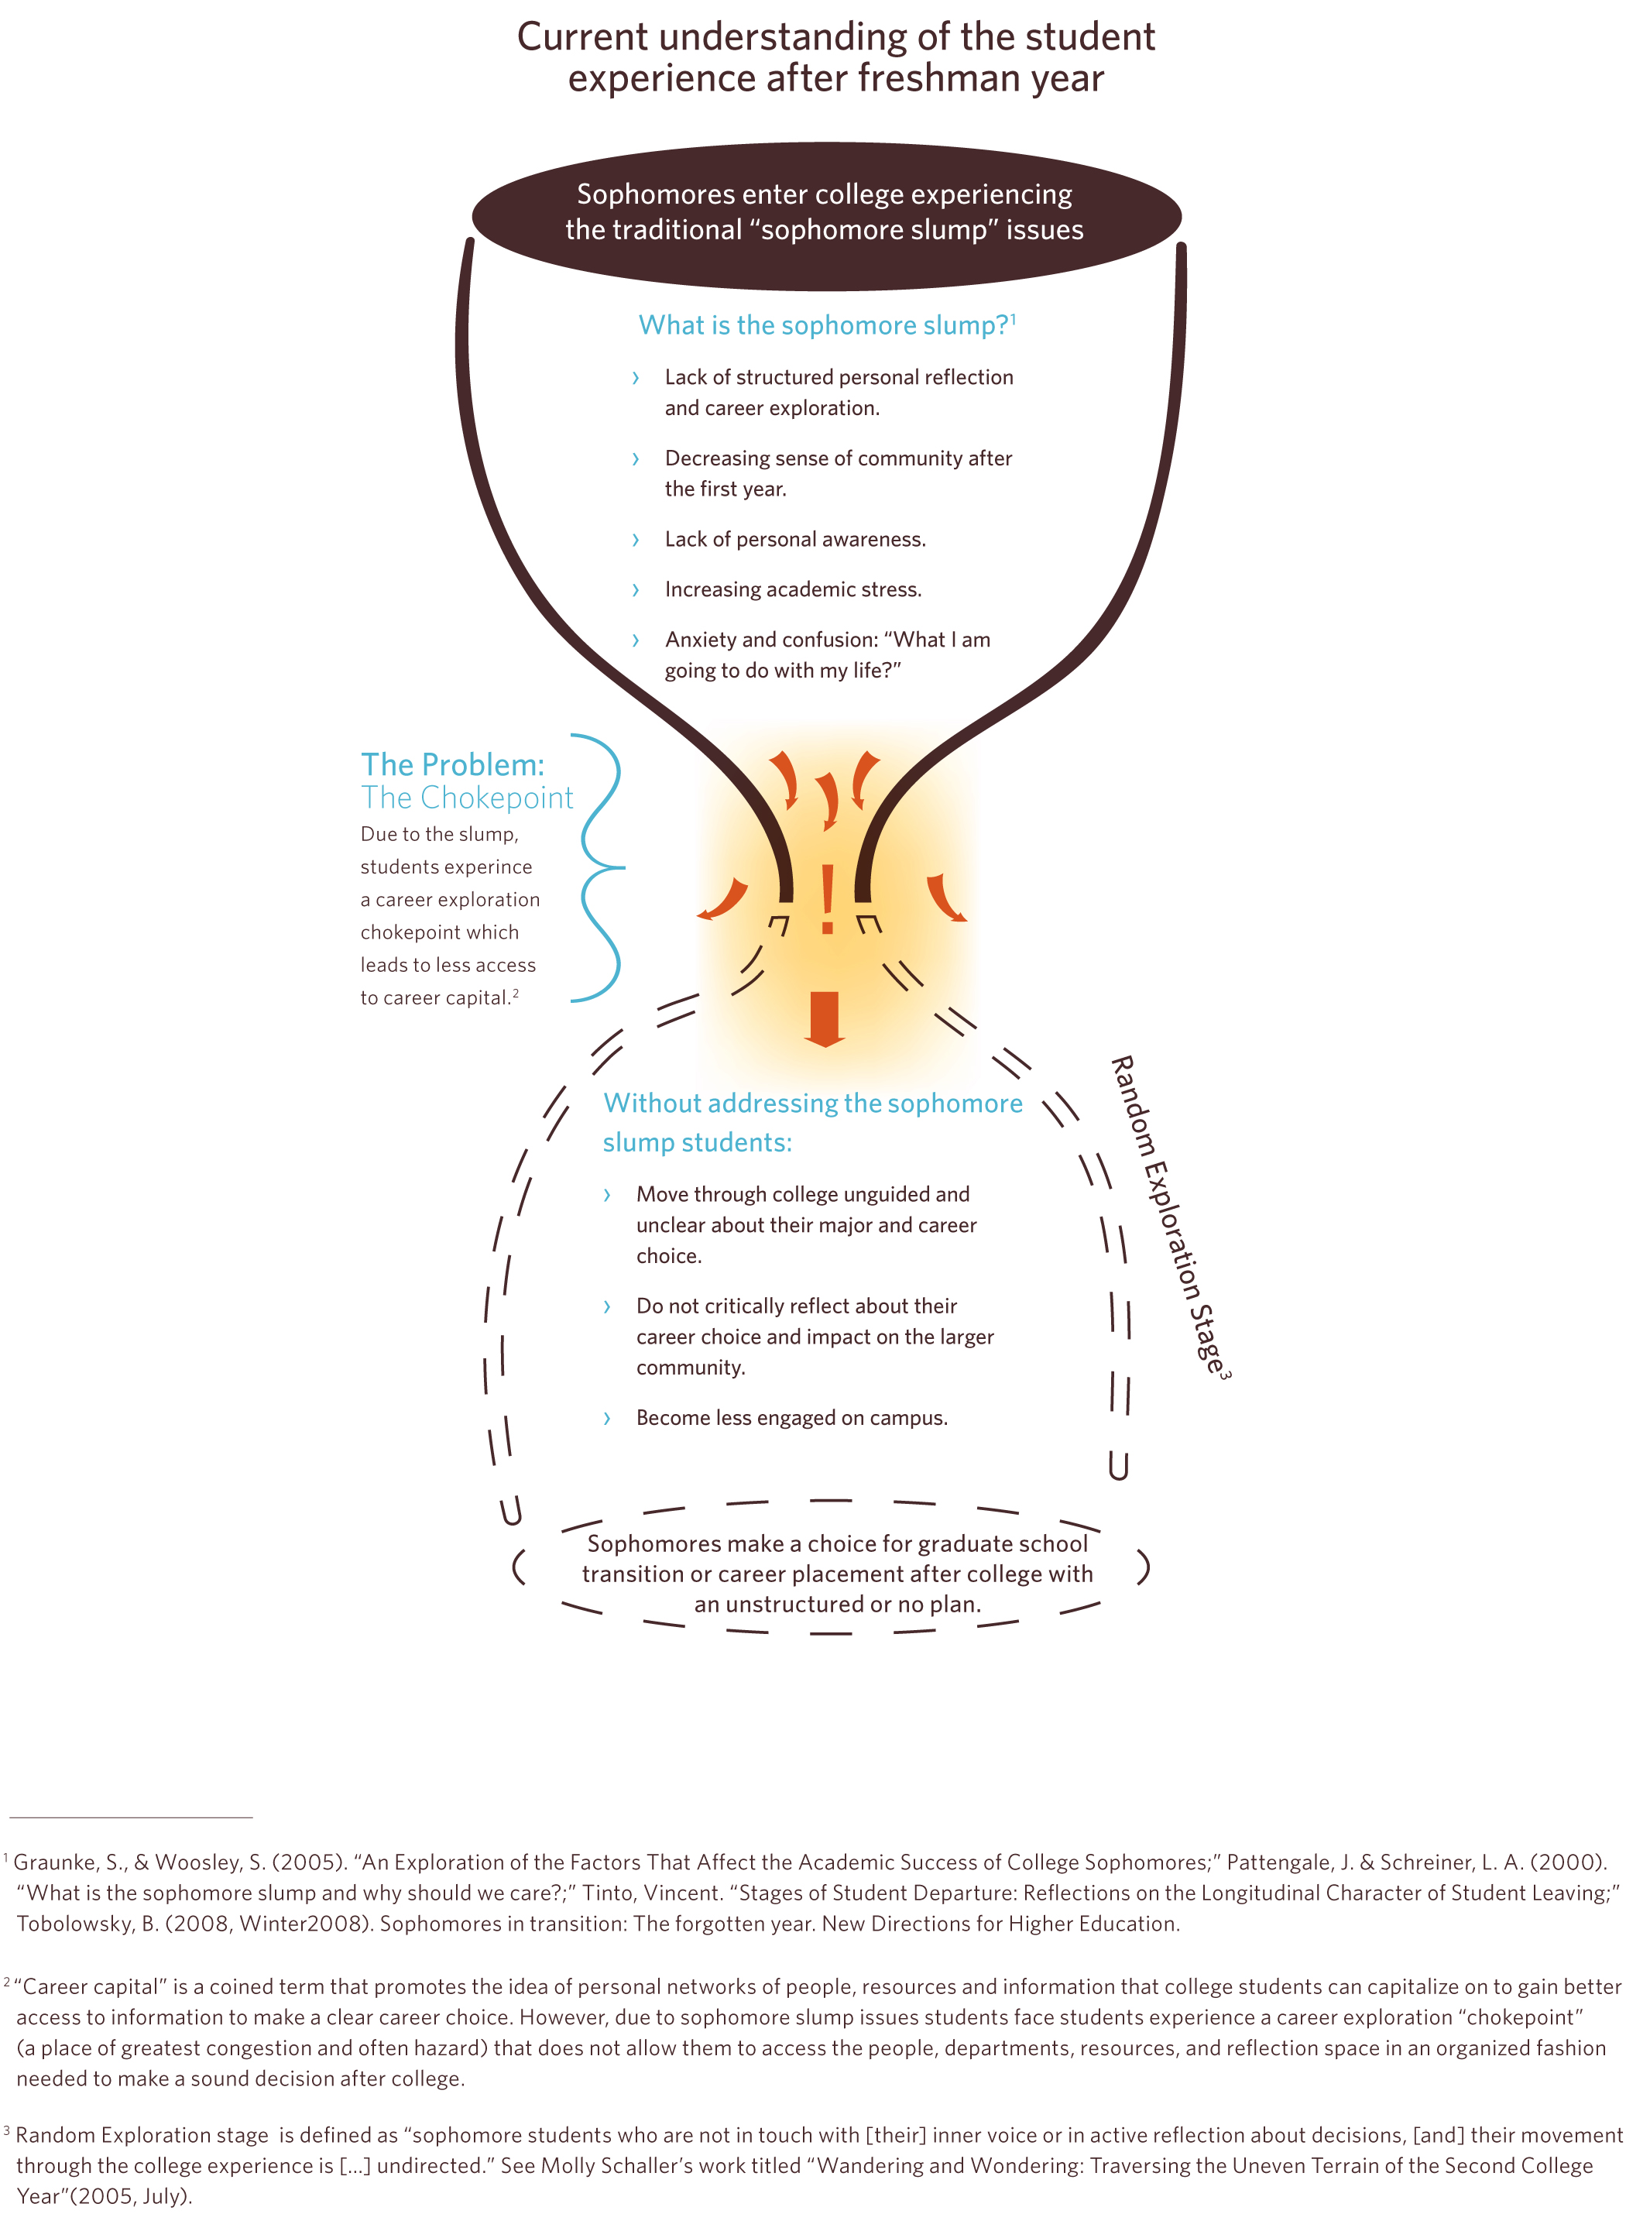
Notes:
Chokepoint
The image is small. It will be shared in our handout
STARS Mentors struggled to find jobs due to the Sophomore Slump, thus Career Exploration Chokepoint (explain quickly)
Students were stuck at the chokepoint, and when they went through their junior and senior year they had not structured plan.
When we discovered the chokepoint, we discovered First-Generation students did not have a roadmap, so we provided the PATHS Roadmap to help them access the career capital needed.

Slide 6
Notes:
Curriculum
A curriculum (roadmap) was created to address four learning domains leading to their career success
Expanded the career discernment approach beyond to included three additional areas: Financial Fitness, Values Identity and Academics, SRL

Slide 7
Notes:
PATHS Roadmap
When we discovered the chokepoint, we provided a PATHS Roadmap.
The PATHS Roadmap provided a series of Focused Exploration Activities, online reflections, and meeting with specific advisors across all learning domains.
This proved to be to confusing and intimidating for our students, thus leading to low engagement in the program.
So, we decided to make it simpler; Eric will explain

Slide 8
Our Current Work
and where we are going
Notes:
Through a strategic planning process, our office came to the conclusion that it was necessary to create an area dedicated to Post-College Success Initiatives.

Slide 9
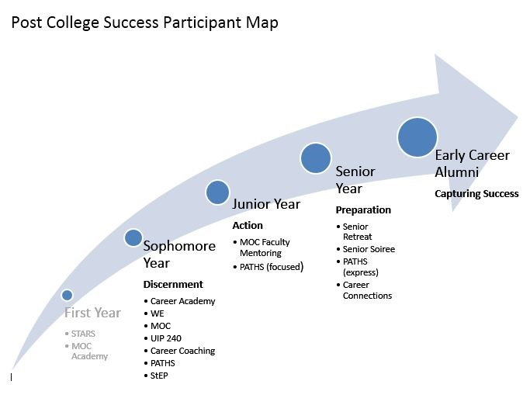
Notes:
Through a smaller strategic planning process that I led with the Post-College Success team, we were able to come up with this participant map
It allows us to provide a visual PATH for our students. Each year is defined by an “process”: discernment, action, preparation and success

Slide 10
Current Practice
Discernment
Action
Participation/Transition
Notes:
As you’ll see, we have three areas that we focus on with our students: Discernment, Action and Preparation and Transition

Slide 11
Discernment
Sophomore Engagement
Career Coaching
UIP 240
Career Academy Sessions
Notes:
Our focus is to provide our target students with an opportunity to engage in critical reflection in a way that allows them to create a career path rooted in their identity and values. We work with students to help them understand how who they are as first-gen students impacts their major and/or career choice. EX:
1:1 experiences (individualized Career Coaching)
as well as small group cohort experiences (UIP 240 or Career Academy
Bonus Engagement
University Internship Program (UIP) 240 Career PATHways Course. UIP 240 is a two-credit course targeted toward OMSS sophomores to help them discern on their career aspirations. The course curriculum was developed using the P.A.T.H.S. learning domains.
High Engagement
Career Coaching. Through individual Career Coaching meetings, students engage in discourse relevant to their specific post-college plans. In addition specific exploration goals, reflection and values discussions are integral parts of the career coaching experience.
Identifying career workshops.
Mid-Level Engagement
Career P.A.T.H.S. Field Trips. Students have the opportunity to engage in on-site visits with various companies and organizations to gain an awareness of real world work experience in their career field of choice.
Lowest Engagement
P.A.T.H.S. E-newsletter. The P.A.T.H.S. e-newsletter is a bi-weekly newsletter that encourages student participation in area specific programs as well as upcoming internship and campus job opportunities.

Slide 12
Notes:
An example of a discernment activity we engage students in is the Career Family Tree
This activity allows first-generation students to visibly see the disconnect that often exists between their experience as college students, and their families experience of them as sons, daughters, cousins, etc. It allows them to make sense of the difficulty they may have in seeing the light at the end of the college tunnel.

Slide 13
Action
Encourage Participation
Internships
Career Fairs
Career Center Workshops, Programs, Activities
Faculty Mentor Development
Notes:
Slide 13 - Action – The action phase is about pushing students to engage in action oriented activities, programs, workshops that can solidify their career path. Encourage participation in
Internships
Attending Career Fairs
Career Center focused
Faculty Mentoring (piloting in MOC)

Slide 14
Transitions
Managing Loss
Managing Transition
Senior Retreat
Emphasis on First-Generation Status Continuation
Notes:
Slide 14 - Preparation and Transition – Ensuring that students are adequately prepared not only for their first job/service experience or graduate school, but also for their transition away from our university.
Phenomena – year after year we talk with highly engaged first-gen students who express a desire to stay on campus for as long as possible. So we explored this further and found that our graduating seniors were afraid of the “real world”. In the same way incoming first-gen students are impacted by the myriad unknowns of college life, our outgoing students are experiencing a sense of loss and uncertainty that is impacting them in very real ways. To a certain degree, our first-gen college students are transitioning into a new identity…that of a first-generation white collar professional or grad student.
Managing Loss – engaging students in reflection allows them to make meaning of their college experiences. For first-gen students, this allows us the opportunity to help them explore the skills they’ve developed as first-gen that they can use once they graduate.
Managing Transition – these transferable skills, which allowed them to build the social capital needed to succeed, will be important in their ability to succeed in the transition to life after DePaul University
Senior Retreat
First-Generation White Collar, first-generation graduate student. These identities, whether they are aware or not, can have a tremendous impact on their ability to be successful in multiple areas of their life as early career alumni.

Slide 15
Capturing Success
Quantitative Data
Career Coaching helped students connect to DePaul resources (82%)
Career Coaching stressed the importance of finding a mentor and building career-relevant relationships. (91%)
Career Coaching helped students consider a wider variety of career options. (77%)
Notes:
RPM Slide

Slide 16
Capturing Success
Qualitative Data
Students demonstrated an understanding and application of career capital.
“I definitely want to be able to establish a stronger networking base, just because, my career coach, was talking about career capital and how crucial that is for everyone’s success and that’s something I want to be able to establish.”
Career Coaching helped students remain accountable to their career goals.
“... if it wasn’t for the meeting times that made me motivated to go and search for what I wanted to do… I’ve had a lot going on this quarter; I mean the whole year has been busy, so if it wasn’t for the scheduled meetings I wouldn’t have done these things.”
Notes:
RPM Slide

Slide 17
Capturing Success
Students articulated the connection between their career goals, personal life purpose, and common good values.
“I feel that in my career I want to be able to implement what I’ve learned because I’m in Women Empowered and DePaul Alliance for Latino Empowerment and a lot of the things I’ve learned from my members, a lot of the things I’ve learned from people in the community have really changed my perspective of how I want to be able to change the world.”
Students felt supported by their Career Coach
“And the fact that he is part of the minority group that is in the career coaching, the people that usually get the career coaching, I felt more connected and comfortable. The whole personality that he has made me more comfortable and helped me believe what he was saying.”
Notes:
RPM Slide

Slide 18
Next Steps
Online Services
Integrating Current OMSS Program Participants
Notes:
Slide 18 - Next Steps
Online Services – Looking at a creating a “course” on D2L so students can go at their own pace
Seamless Integration of current OMSS program participants

Slide 19
How do we connect with the Career Center...
...and how we're different
Notes:
The number one question, we are asked by our colleagues, and university partners is; How are we different?

Slide 20
How do we connect with the Career Center
Career Center staff serves as strong advocates for first-generation students.
Sharing and promotion of resources and Career Center workshops and events to our student population.
Collaboration and partnerships with University Internship Program to create for-credit course designed for first-generation students.
Annual summer meetings with campus partners to identify trends in each area and create strategies for improvement.
Notes:
Career Center Staff are advocates and direct contacts for our students
Sharing and promotion of resources; we have the students, they have resources
UIP 240 Collaboration; we were doing the same work, merged. We had the students; they have the credits.
Annual Summer Meetings are important! Provided updates and strategies for improvement; doing this for five years.

Slide 21
How are we different?
OMSS
Career Center
Discernment
Create customized action plans
Transition
Thinking
(Reflective Practice)
Tangible assessments
Tools to implement action plans.
Internships and job
Doing
(Transactional)
Notes:
How are we different?
Because of the strong partnerships, we are able to do the following:
• OMSS – Thinking (Reflective Practice)
• Career Center – Doing (Transitional)
Eric will share more Things to Consider to create this experience on your campuses

Slide 22
Things to Consider
Partnerships can create direct access to underrepresented groups
Which offices engage this segment of your student population?
How have/can you partner for increased student participation?
Career Self-Efficacy
Notes:
High Career Self-Efficacy = increased capacity to engage in career seeking behavior
Low Career Self-Efficacy = decreased capacity to engage in career seeking behavior
What we’re trying to do with our Sophomore initiatives is to increase a students’ career self-efficacy.

Slide 23
Questions
Thank you.
Eric Mata, emata3@depaul.edu; Richard Morales, rmorales150@ccc.edu

Slide 24
References
Constantine, M. G., & Flores, L. Y. (2006). Psychological distress, perceived family conflict, and career development issues in college students of color. Journal of Career Assessment, 14(3), 354-369.
Caridad Sanchez-Leguelinel. (2008). Supporting 'Slumping' Sophomores: Programmatic Peer Initiatives Designed To Enhance Retention in the Crucial Second Year of College. College Student Journal,B 42(2), 637-646. Retrieved February 25, 2009, from ProQuest Education Journals database. (Document ID: 1485911731).
Duffy, R. D., & Sedlacek, W. E. (2010). The salience of a career calling among college students: Exploring group differences and links to religiousness, life meaning, and life satisfaction. The Career Development Quarterly, 59(1), 27-41
Graunke, S., & Woosley, S. (2005). An Exploration of the Factors That Affect the Academic Success of College Sophomores. College Student Journal, 39(2), 367-76. Retrieved February 20, 2009, from OmniFile Full Text Select database.
Luzzo, D. A. (1995). Gender differences in college students' career maturity and perceived barriers in career development. Journal of Counseling & Development,73(3), 319-322
Metheny, J., & McWhirter, E. H. (2013). Contributions of social status and family support to college students’ career decision self-efficacy and outcome expectations. Journal of Career Assessment, 0(0), 1-17.
Olson, J. S. (2013). Opportunities, obstacles, and options: First-generation college graduates and social cognitive career theory. Journal of Career Development.
Rios-Aguilar, C., & Deil-Amen, R. (2012). Beyond getting in and fitting in: An examination of social networks and professionally relevant social capital among Latina/o university students. Journal of Hispanic Higher Education,11(2), 179-196.
Schaller, M. (2005, July). Wandering and Wondering: Traversing the Uneven Terrain of the Second College Year. About Campus, 10(3), 17-24. Retrieved February 20, 2009, from Professional Development Collection database.
Tinto, Vincent. “Stages of Student Departure: Reflections on the Longitudinal Character of Student Leaving.” The Journal of Higher Education Jul. - Aug., 1988 Vol. 59, No. 4. pp. 438-455.
Tobolowsky, B. (2008, Winter2008). Sophomores in transition: The forgotten year. New Directions for Higher Education, Retrieved February 25, 2009, from Academic Search Premier database.
Wells, Ryan (2009). Social and Cultural Capital, Race and Ethnicity, and College Student Retention. Journal of College Student Retention, 10(2), 103-128. Retrieved January 21, 2009, from ProQuest Education Journals database. (Document ID: 1530336921).
Winslow, Rick. (2006). Sophomore Program Begins Where First-Year Program Ends. Recruitment and Retention in Higher Education, 20(7), 1, 4. Retrieved February 25, 2009, from OmniFile Full Text Select database.

