Slide 2
Creating Seamless Learning Environments for Graduate Students in Student Affairs Preparation Programs
Danielle M. DeSawal, Indiana University
Frank E. Ross III, Northeastern Illinois University

Slide 3
Welcome & Session Overview
Context for the assignment
Importance of supervised practice in student affairs
Role of Reflection, Seamless Learning & Socialization
Creating Conditions for Seamless Learning
Overview of Formal Assignment
Connection to Core Competencies
Discussion

Slide 4
Context for the assignment
Curriculum Review
Team consisted of faculty, assistantship providers and current students
Learning outcomes align with the Liberal Education & America’s Promise (LEAP) learning outcomes from the Association of American Colleges & Universities (AAC&U)
Redesigned to meet the needs of graduate education and student affairs practice
Curriculum is inclusive of both the academic classroom and the paraprofessional role
Assistantships are required of all students enrolled in the masters program
Identified Need: More intentional connection between the two experiences that can provide a professional developmental frame for the student

Slide 5
Supervised practice has become a hallmark of how the field socializes future student affairs professionals (Cooper, Saunders, Winston, Hirt, Creamer, & Janosik, 2002).
Literature and Research
Practice
Student Learning
Course Assignments
Supervised Practice

Slide 6
Frequently used within the academic classroom to encourage the student to make connections between literature content and their practice.
Not as frequent is the intentional use of reflection to enhance supervised practice as it relates to current literature and research in the field.
Liddell, Wilson, Pasquesi, Hirschey, & Boyle (2014) identified that graduate students link in class experiences to understanding the role of professional associations, value of self-evaluation and modeling ethical practice in the field.

Slide 7
Role of Socialization
Socialization processes at the graduate level are reflective of the chosen discipline, structure and sequence of the academic program and university setting (Weidman, Twale, & Stein, 2001).
Supervision has been identified as key to socializing and retaining new professionals in student affairs (Davis, 2013;Tull, Hirt, & Saunders, 2009).
Davis (2013) points out that new professionals consistently report dissatisfaction with their supervisory and entrance to the profession.
Liddell, Wilson, Pasquesi, Hirschey, & Boyle (2014) “found out-of-class experiential opportunities in graduate preparation programs to be more influential than in-class experiences when it came to students’ understanding of institutional culture and politics, expanding professional networks, and understanding professional expectations” (p. 81).

Slide 8
Seamless Learning
Seamless learning environments encourage students to use learning resources that are part of both the academic classroom and their out-of-class activities (ACPA, 1994; Kuh, 1996).
Kuh (1996) outlined guiding principles for creating seamless learning environments at the undergraduate level. The following principles resonate with graduate preparation:
Generate enthusiasm for institutional renewal
Develop a common language
Foster collaboration and cross-functional dialogue
Examine the influence of student culture on student learning
These principles can be transferrable to the graduate level, when consideration for graduate socialization is considered.

Slide 9
Creating the Conditions for Seamless Learning
Combination of reflection, scholarship, and application
Intentional design reflects alignment with principles for seamless learning
Faculty and administrators are engaged in the review of the material (Generate enthusiasm for institutional renewal)
Written sections are focused on the professions theoretical foundation (Develop a common language)
Discussion is encouraged related to areas of growth that can be intentionally designed for the following academic year (Foster collaboration and cross-functional dialogue)
Focus of the scholarship is to link how the student has come to understand their application of theory to practice (Examine the influence of student culture on student learning)

Slide 10
Common Language
Literature and Research
Generate enthusiasm for institutional renewal
Influence of student culture
Generate enthusiasm for institutional renewal
Practice
Student Learning
Course Assignments
Supervised Practice
Foster Collaboration & Cross-functional dialogue

Slide 11
Assignment Details
Three sections represent foundational components of the profession for reflection
Part One: Role of Mission
Part Two: Holistic Development from a Professional Lens
Part Three: Good Practices in Student Affairs

Slide 12
Next Steps – aligning the experiences with professional competencies
Approximately three-quarters of new professionals (self identified through their ACPA membership as entry level) responded in a recent survey that they were unaware if their graduate program utilized the ACPA/NASPA professional competencies (Liddell, Wilson, Pasquesi, Hirschey, & Boyle, 2014).
The ACPA/NASPA Professional Competencies for Student Affairs (established July 2010) can provide a framework for follow-up discussions.

Slide 13
ACPA/NASPA Professional Competencies: NASPA Professional Competencies Icons
 | Advising & Helping |  | Human & Organizational Resources
 | Assessment, Evaluation & Research |  | Law, Policy, and Governance
 | Equity, Diversity, and Inclusion |  | Leadership
 | Ethical Professional Practice |  | Personal Foundations
 | History, Philosophy, and Values |  | Student Learning & Development

Slide 14
Beginner, Intermediate & Advanced
The Professional Competencies have three levels for each competency:
Beginner
Intermediate
Advanced
Resource: ACPA Rubrics for Professional Development
http://www.myacpa.org/sites/default/files/professional-comp-rubrics.pdf

Slide 15
Discussion
What are some best practices you use to create connections for graduate students between the academic coursework and paraprofessional experiences?
What are some mechanisms we can put in place during the graduate socialization process to reduce the dissatisfaction we are seeing with new professionals?

Slide 16
Contact Information
Danielle M. DeSawal
ddesawal@indiana.edu
Frank E. Ross III
feross@neiu.edu

Slide 17
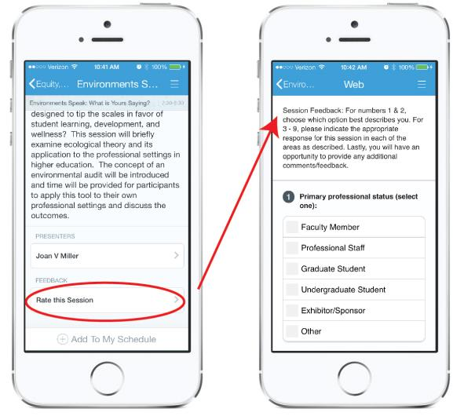
Please Rate This Session in Guidebook
Find this session in Guidebook
Scroll to bottom and click on “Rate this session”
Complete Session Feedback Form

