Slide 1
Student Learning Imperative: More Imperative Today than 20 Years Ago
Andrew Beckett, University of Iowa
Susan Fanale, Saint Louis University
Kirsten Kennedy, University of South Carolina
John Purdie, Western Washington University
Kristen Temple, University of Missouri

Slide 2
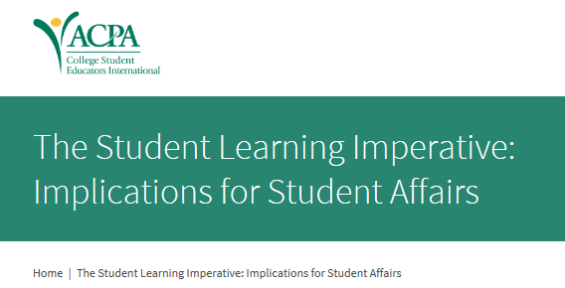
20 Years of the SLI
Notes:
Originators:
Alexander Astin
Helen Astin
]Paul bloland
K. Patricia Cross
James Hurst
George Kuh
Theodore Marchese
Elizabeth Nuss
Ernest Pascarella
Anne Pruitt
Michael Rooney
Charles Schroeder

Slide 3
Complements Institutional Mission
Student Affairs division mission complements the institution’s mission, with the enhancement of student learning and personal development being the primary goal.

Slide 4
Resources
2) Resources allocated to encourage student learning/personal development.

Slide 5
Collaboration
3) Student affairs professionals collaborate with other institutional agents to promote student learning/personal development.

Slide 6
Experts on Students
4) The division of student affairs includes staff who are experts on students, their environments, and teaching/learning processes.

Slide 7
Promising Practices
5) Student affairs policies/programs are based on promising practices from the research on student learning and institution-specific assessment data.

Slide 8
Environmental Changes

Slide 9
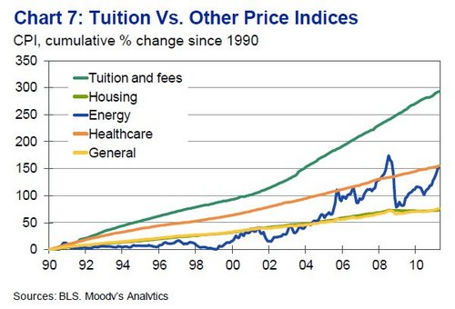
Dramatic Increase in Tuition
Average tuition at public 4-year colleges in 93-94 was $2,431 ($3,933 in today’s dollars)
This year it was $8,266
Notes:
Source: College Board

Slide 10
Dramatic Increase in Borrowing for College
In 1992-93, 49% of graduates borrowed, with an average debt of $15,000 (2009 dollars)
In 2007-2008, 66% of graduates borrowed, with an average debt of $24,700 (2009 dollars)
Notes:
Source: Stats in Brief, U.S. Department of Education 2013, NCES 2014-011

Slide 11
Continued Calls for Reform & Accountability
No Child Left Behind (2001)
Spellings Commission (2006)
Voluntary System of Accountability (2008)
Various reforms by state
President Obama’s Proposal
Cost, value, and quality
Focus on assessment and learning outcomes

Slide 12
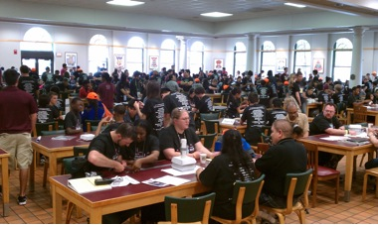
Institutional Focus on Enrollment
Retaining current students
Expanding international population
Attracting more domestic students has led to the “Keeping up with the Jones’ effect”
New residence halls
New recreation facilities
New student unions
Notes:
As aid decreases and students pay more, institutions have relied more on enrollment

Slide 13
Other Factors
Focus on legal issues and student safety
Competition from “For Profits,” third party vendors, off-campus housing, outsourcing
Online learning
Increased expectations from diverse constituents (governing boards, legislatures, parents)
Increased role of fundraising

Slide 14
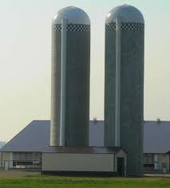
Current Challenges
Doing more with less
Still silo-ed organizations
Influx of non traditional students utilizing on-line delivery methods
Delta Cost Project
Employability skills

Slide 15
Discussion

Slide 16
How did the profession respond to the SLI?
What changes have you seen in our work during your student affairs tenure?
Complements institutional mission
Resources
Collaboration
Experts on students
Promising practices/assessment

Slide 17
How may we reinvent our work to meet the needs of tomorrow’s students?
Do you know what students your institution is recruiting and what those students might need?
What tools are you using that are no longer relevant?
Do we need to reinvent our work? Why or why not?

Slide 18
What are the barriers that prevent us from focusing on learning and development?
What issues are you dealing with on your campus?
How are they different from your colleagues?
Why might the issues be different from your colleagues?

Slide 19
Given the changes over the last 20 years…
What parts of the SLI remain relevant?
Which parts are obsolete?
Given the current environment, what would you add?
Complements institutional mission
Resources
Collaboration
Experts on students
Promising practices

Slide 20
One Size Does Not Fit All

Slide 21
One Size Does Not Fit All
Traditional
Out-of-classroom-Centered
Extra Curricular
Co-Curricular
Administrative-Centered
Functional Silos
Student Services
Learning-Centered
Competitive and Adversarial
Seamless Learning
From Manning, Kinzie & Schuh (2014). One size does not fit all. Routledge Publishing

Slide 22
One Size Does Not Fit All
Innovative
Student Centered
Ethic of Care
Student-Driven
Student Agency
Academic Centered
Academic-Student Affairs Collaboration
Academic-Driven

Slide 23
Conclusions

Slide 25
Mission
Is it aligned with the institution’s mission?
Are learning and development at the core of our work?
What is the role of helping students develop “employability skills?”

Slide 26
Resources
Are resources allocated to reflect a mission of learning and development?
When resources are scarce, what is our priority?

Slide 27
Collaboration
What is expected in collaborating with others?
What are the outcomes of collaboration?
What other institutional partnerships do we need to build to be successful now?

Slide 28
Experts
What do we know about our studetns?
How can our graduate programs produce “student experts?”
How do we share our knowledge of student learning with campus partners?

Slide 29
Promising Practices & Assessment
Are we data driven or anecdote driven?
How have our policies and practices changed over the past two decades based on research/assessment?
What else do we need to know to thrive in the future?

